Slide 1
API Testing

Slide 2
Content
Application coverage
Technology
Project structure
Bamboo plan
Worth mentioning

Slide 3
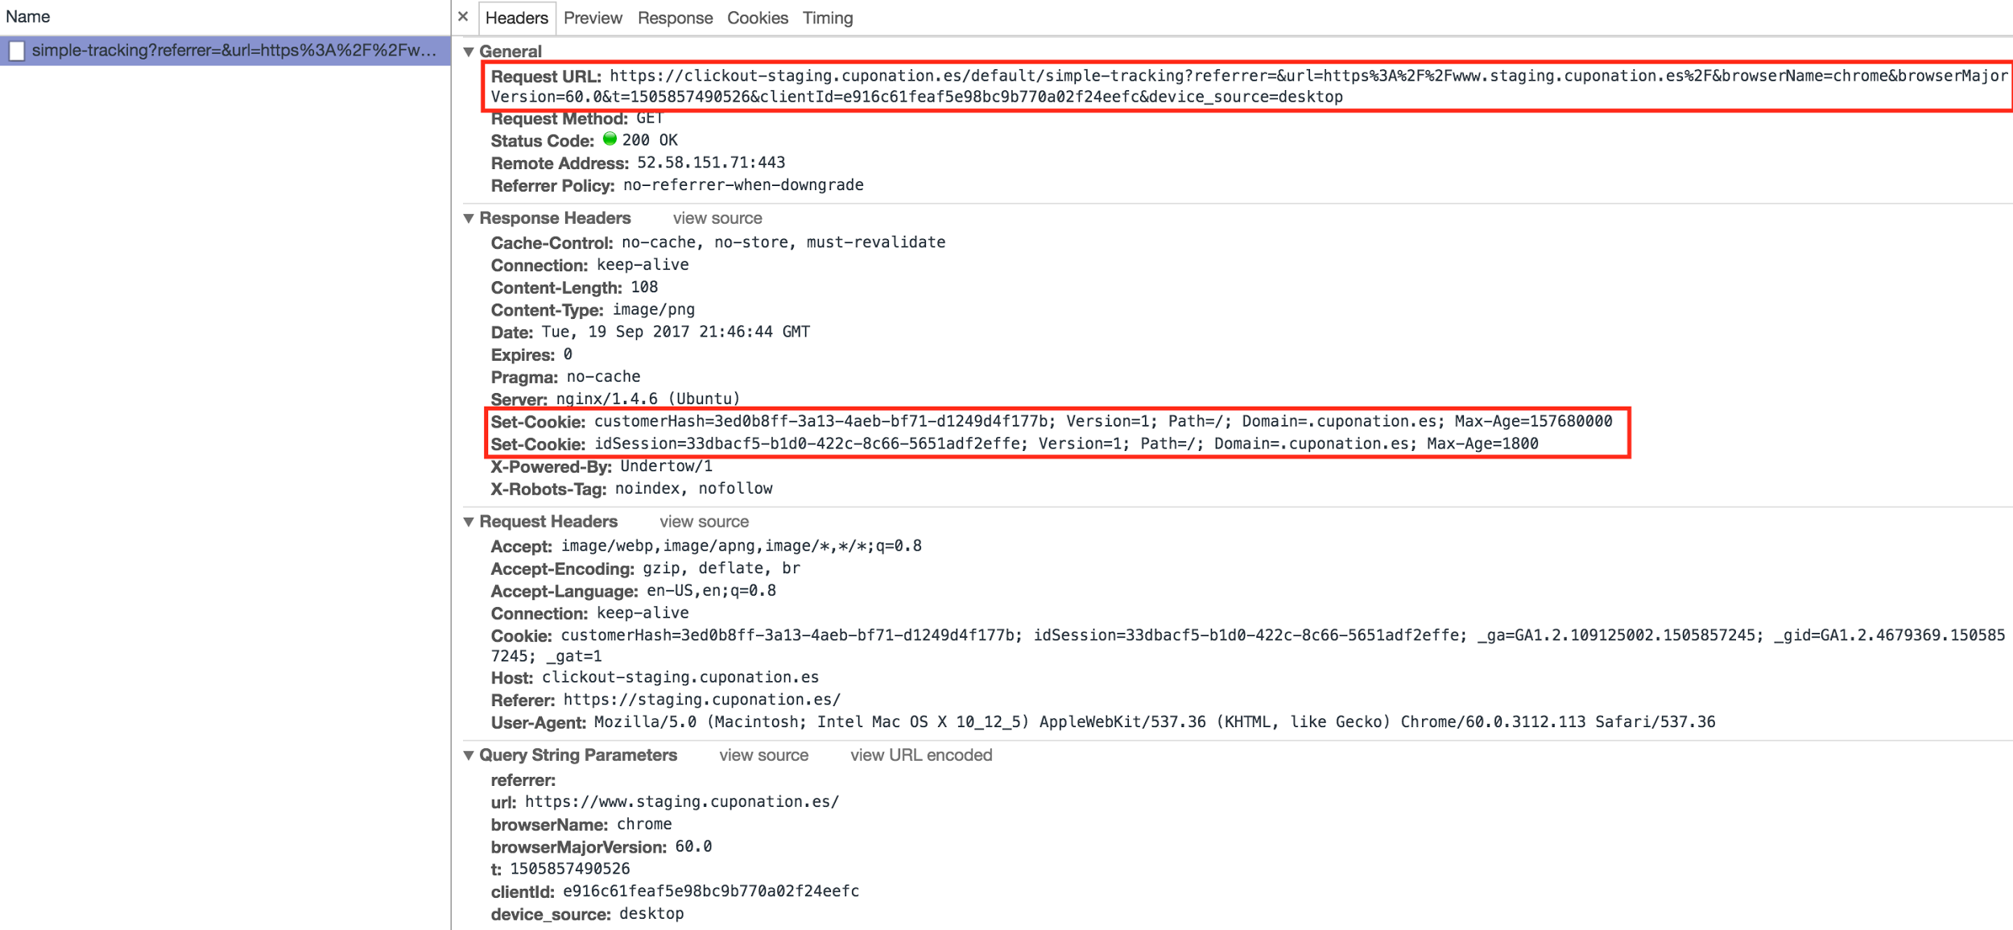
Application coverage - Simple tracking API

Slide 4
Technology
JAVA 8
Rest-Assured
Mongo
MySQL

Slide 5
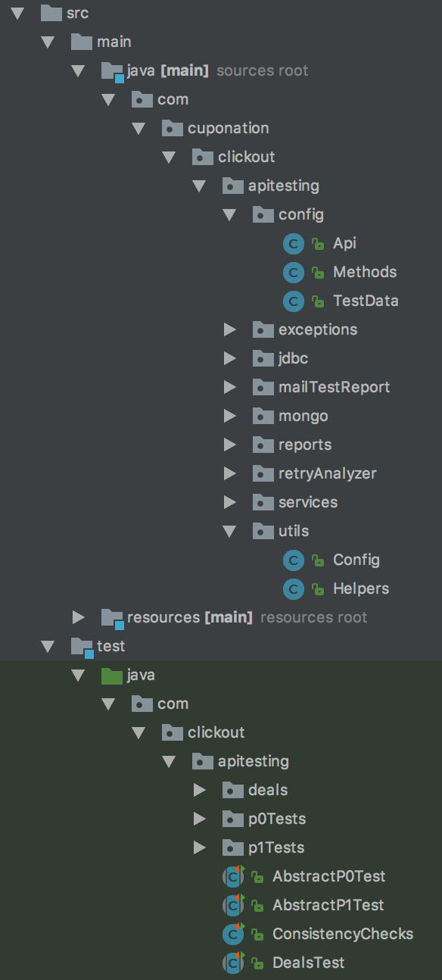
Project structure
Main parts:
Methods,Helpers
Abstract Tests Classes
TestData

Slide 6
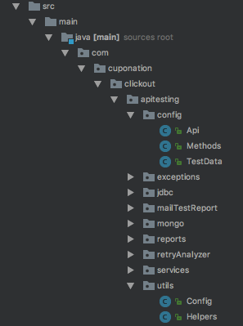
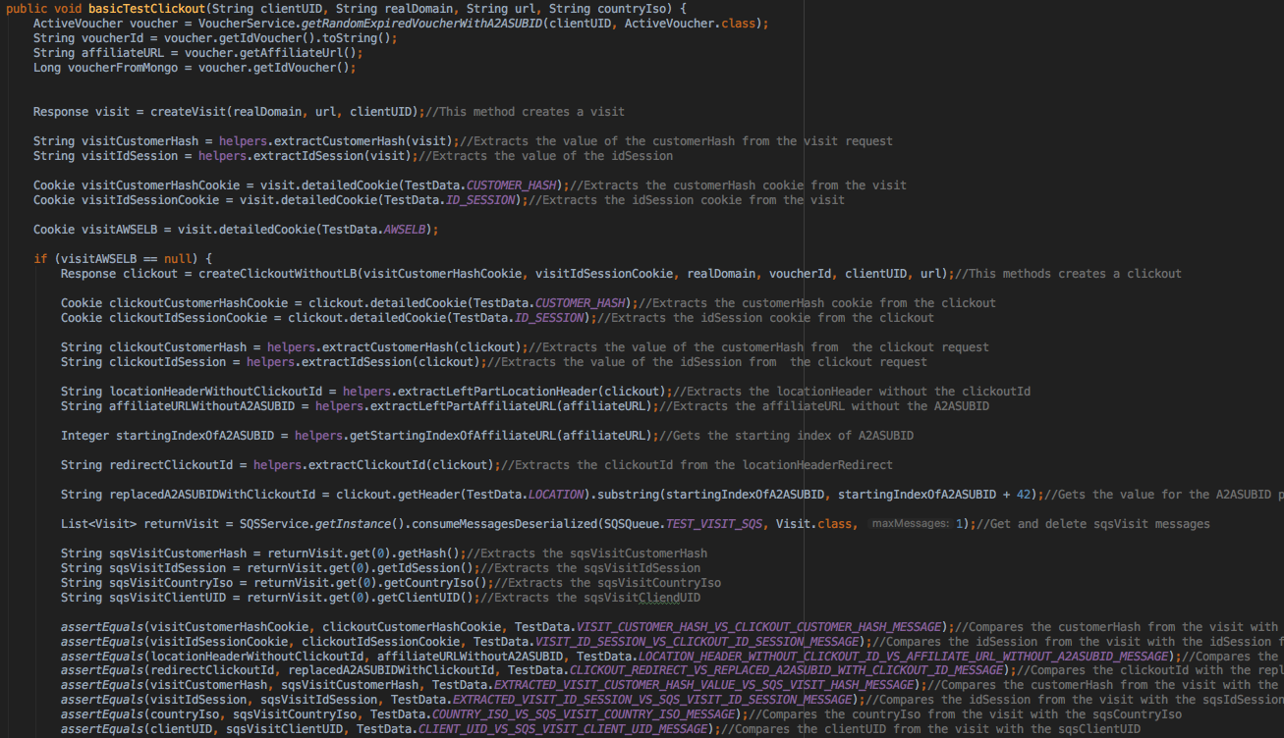
Project structure - POM

Slide 7
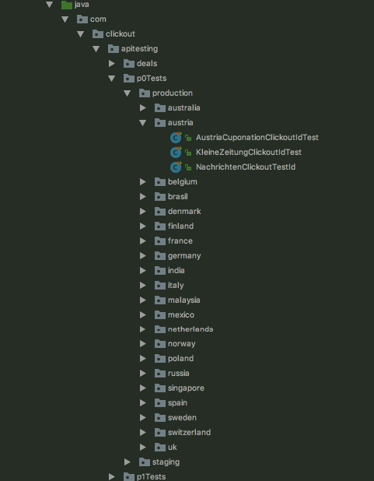
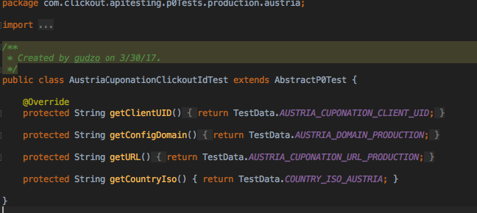
Project structure - Each client has its own class where the data is stored

Slide 8
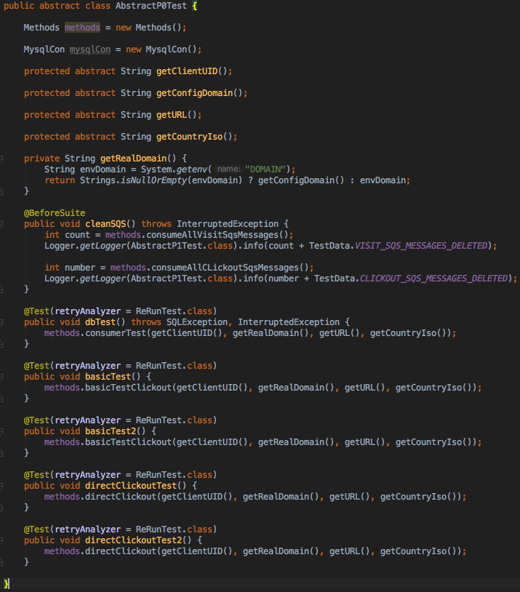
Project structure - How the test looks

Slide 9
Project structure - Environment and test suite
Running parameters

Slide 10
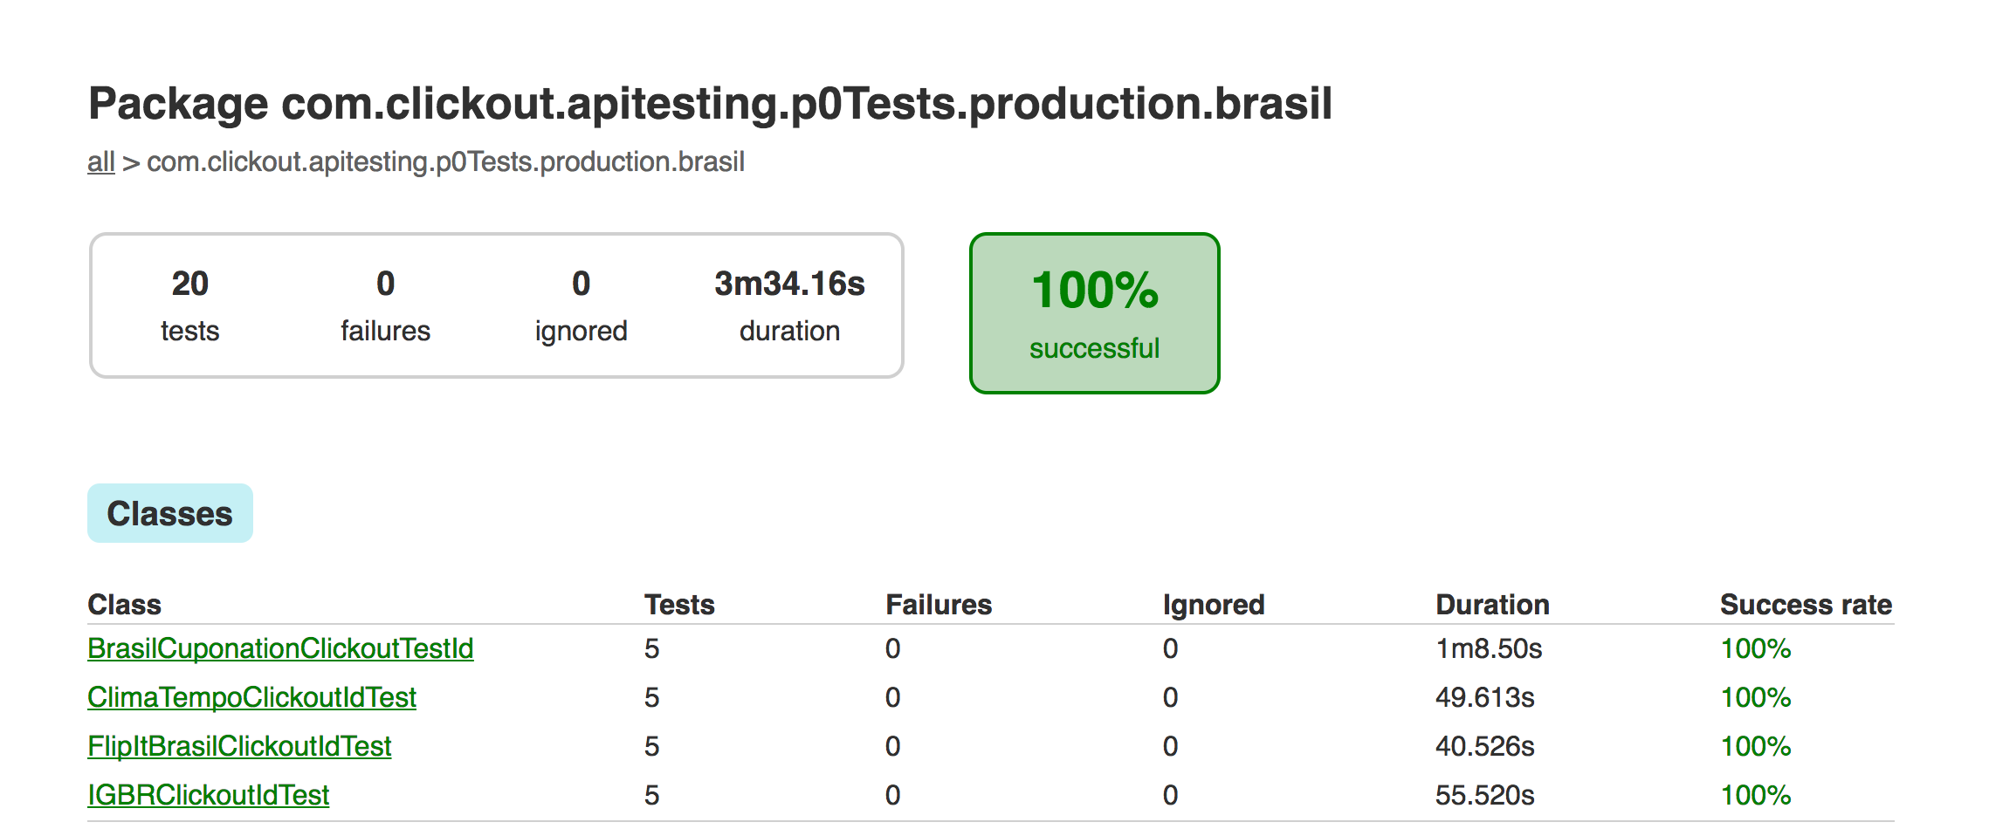
Test reports

Slide 11
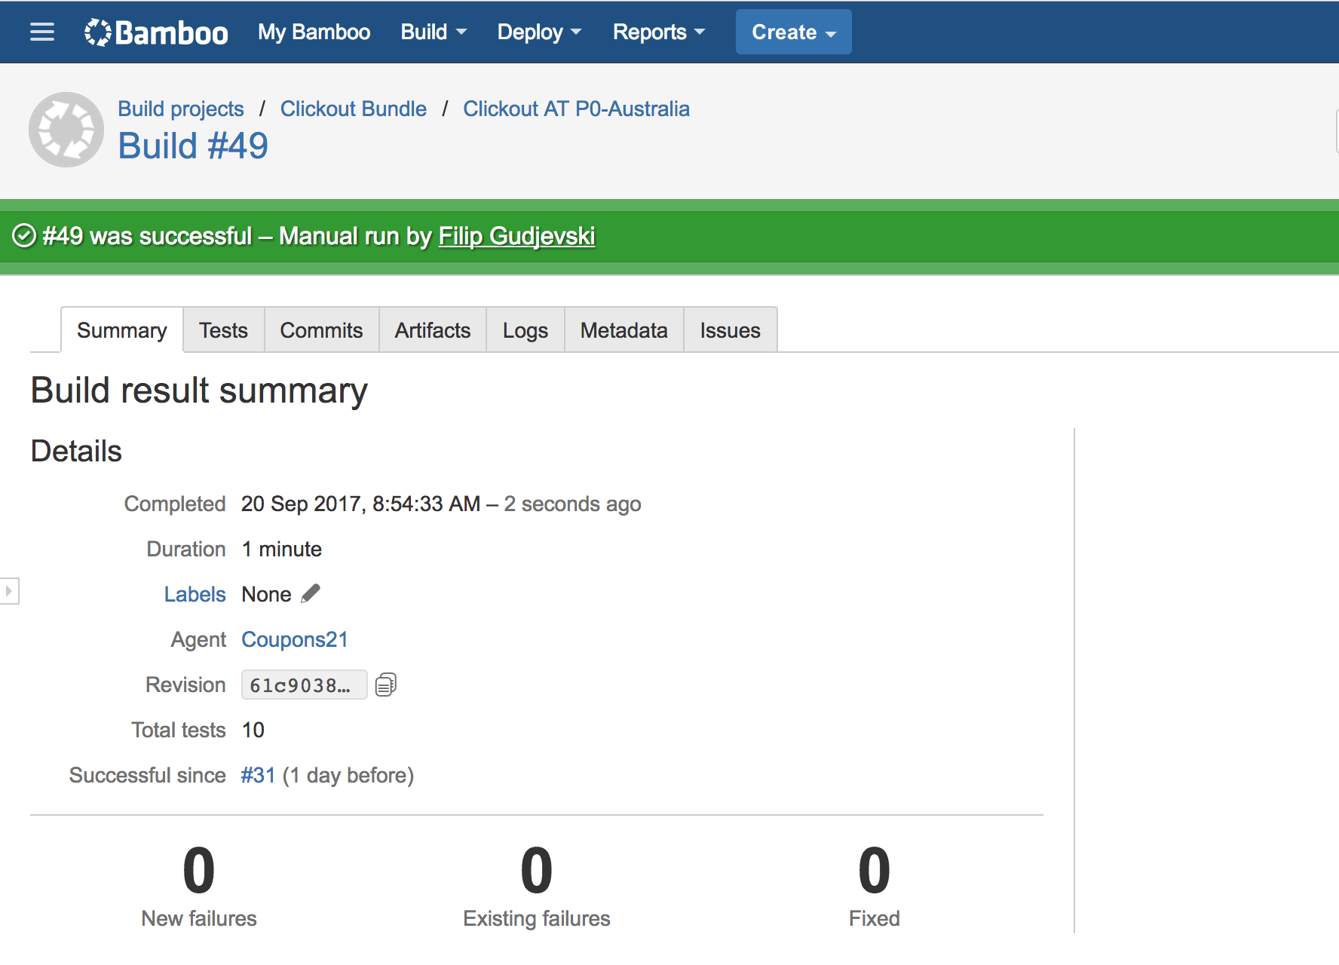
Bamboo plan
Tests - from 1 to 10 mins (region)
Cron job - Every 2 hours

Slide 12
Worth mentioning
Retry
Logging
Error messages

Slide 13
QUESTIONS

